Slide 1
Kernel PCA
Seminar 3
Sergey Ivanov

Slide 2
Plan:
What is Principal Component Analysis?
Problem Formulation and Motivation
Algorithm and its properties
How to choose number of components
Pros and Cons of PCA
What is Kernel PCA?
Problem Formulation and Motivation
Kernel Trick and properties of KPCA
Different Kernels
Tutorial on PCA/KPCA in Python
Exercise Session
Kaggle Digit Recognizer with PCA and KPCA (if we have time)
Data and Evaluation
Writing your code
References:
Theory:
PCA/KPCA in sklearn
Decomposition in Python
Princeton Tutorial on PCA
Ng Tutorial on PCA
Machinelearning.ru tutorial on PCA
Smola on KPCA
Slides on KPCA
PCA with Linear Algebra
Whitening explained
Smola slides on KPCA
Wiki on KPCA
A tutorial on KPCA
Dimensionality Reduction Tutorial
Practice:
Python PCA tutorial
Python KPCA tutorial

Slide 3
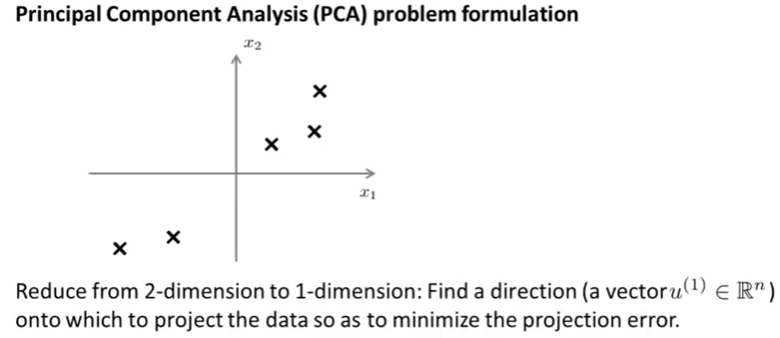

Slide 4
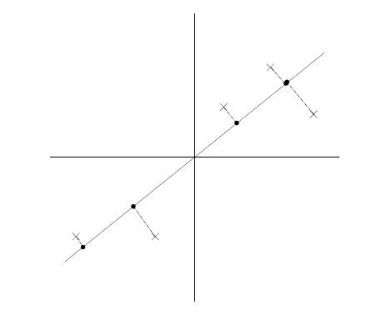
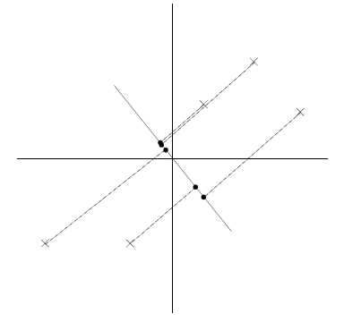
Intuition

Slide 5
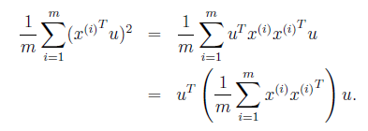
Intuition

Slide 6
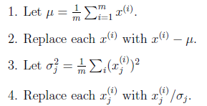
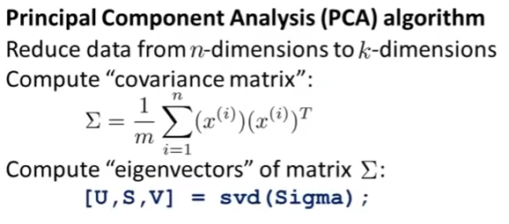

Algorithm

Slide 7
Properties of Principal Components
Maximize variance
Orthogonal

Slide 8
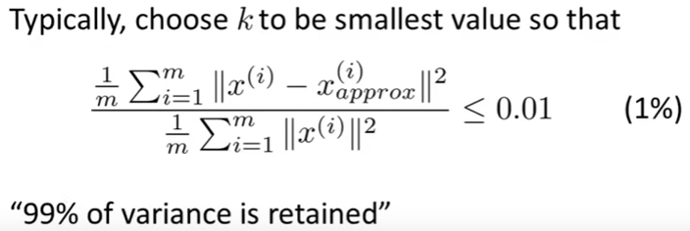
Choosing the number of principal components

Slide 9
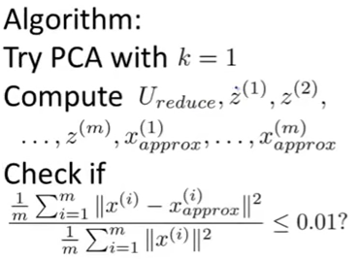
Choosing the number of principal components

Slide 10
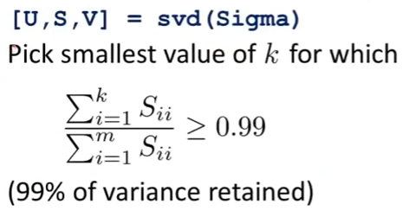
Choosing the number of principal components

Slide 11
Advantages of PCA
Compression of Data (memory/speed-up increase)
Visualization purposes
Selection of features

Slide 12
Disadvantages of PCA
Throw away data
All data must fit into memory

Slide 13
Summary
PCA is a linear transformation of basis that maximizes variance of data
PCA is used for dimensionality reduction by throwing away components with small eigenvalues

Slide 14
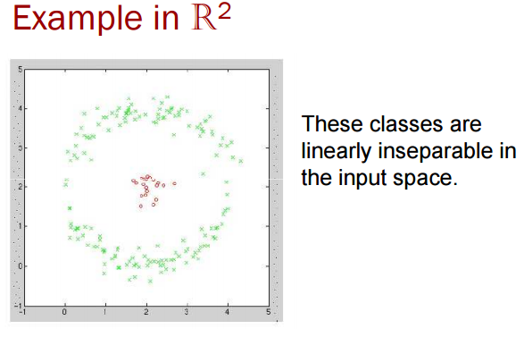
Kernel PCA: Motivation

Slide 15
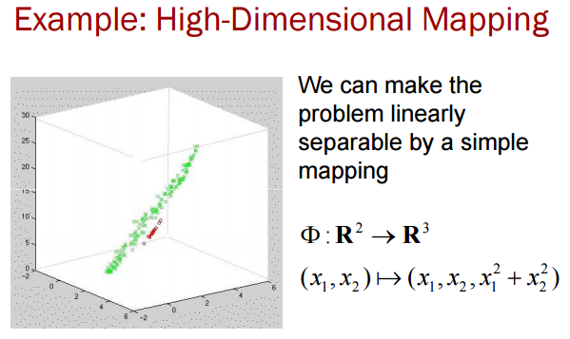
Kernel PCA: Motivation

Slide 16
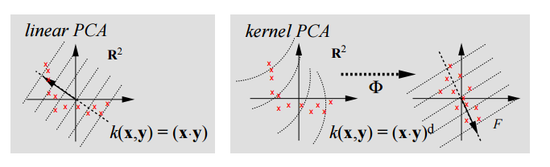
Kernel PCA: Motivation

Slide 17
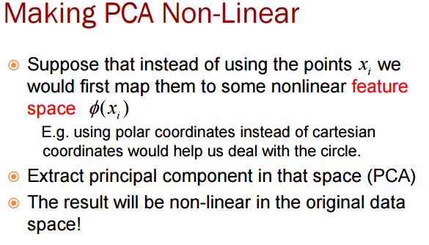

Slide 18
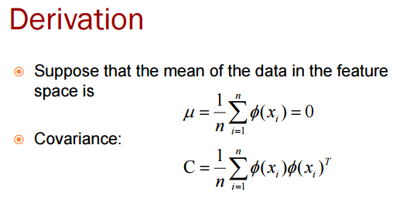

Slide 19
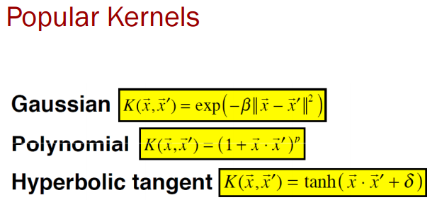

Slide 20
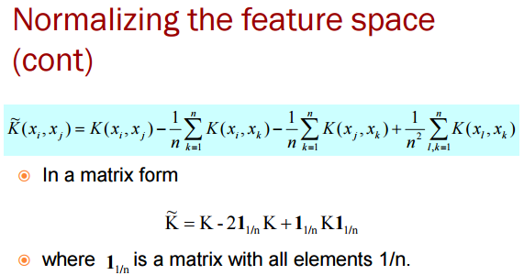

Slide 21
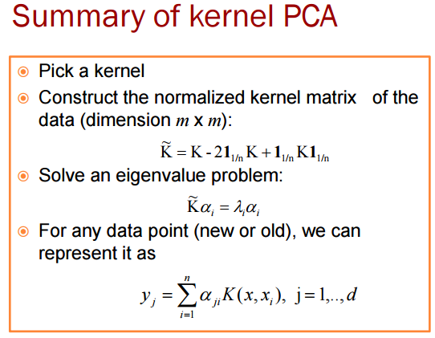

Slide 22
